Slide 1
Power Curve Working Group What are the issues?
Daniel Stevens
Resource Assessment, SSE Renewables
04 December 2012

Slide 2
The issues
Power performance in the real world
Mitigating the risk of underperformance
Working closer
SSE Renewables welcomes the formation of this Working Group!

Slide 3
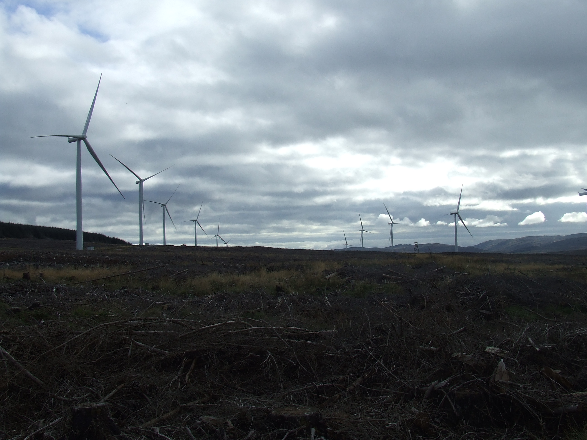
1) Power performance in the real world

Slide 4
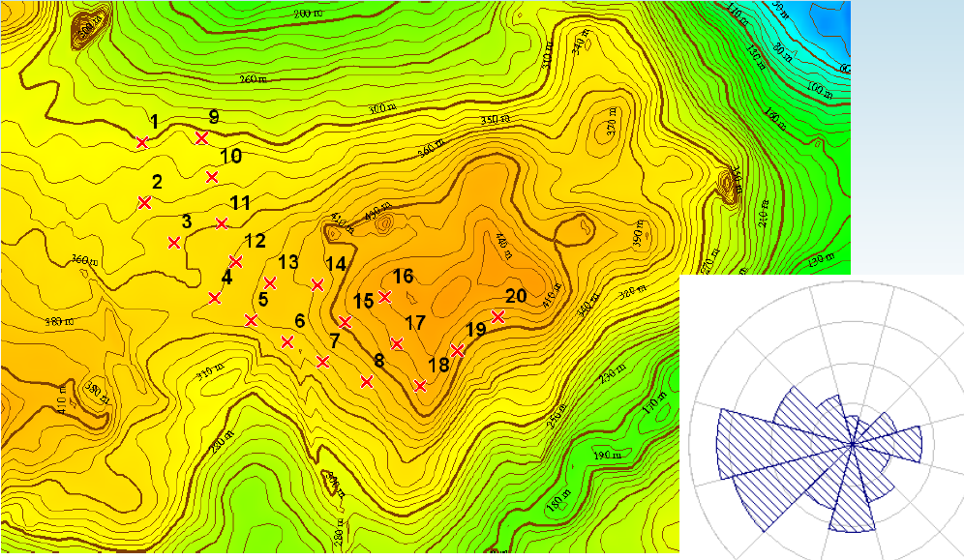
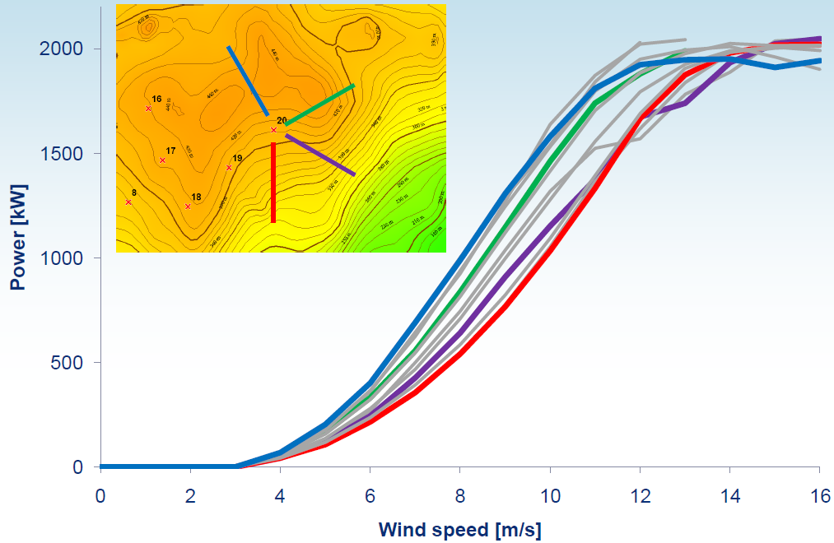
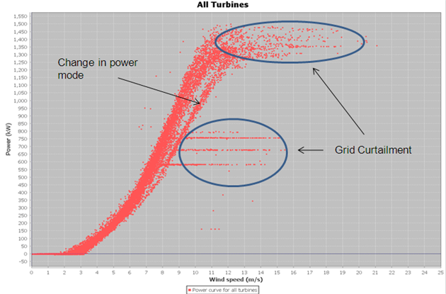
Weak performance: identifying, predicting
Performance tracking using 10 minute data: the ‘APA’ team in SSE
Wind Farm level
WTG
level
Establishing cause
Quantifying AEP impact

Slide 5
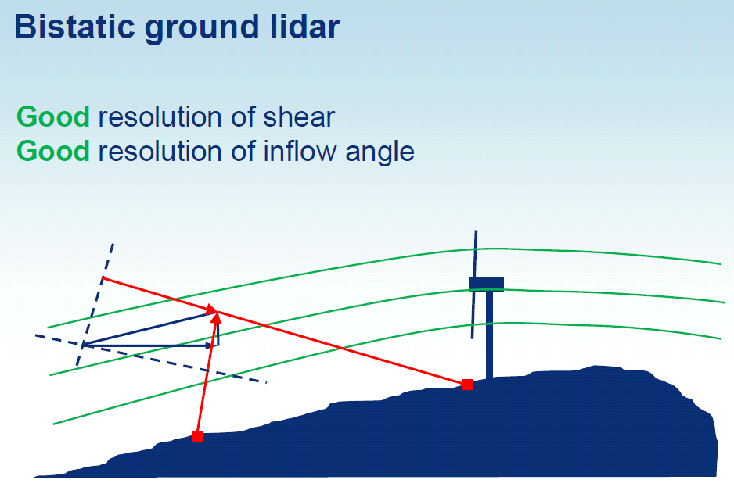
Establishing reasons for underpeformance
Quantifying impact of conditions on power performance
CFD and Remote Sensing both have a role to play
Expensive
e.g. Fairburn inflow angle study
Validation across many sites required to inform loss factors

Slide 6
Turbine suitability analysis
Excessive turbine fatigue loads are caused by:
High/negative shear
High turbulence (ambient, wake induced)
High inflow angle
Mitigated by moving WTGs or curtailing/load control systems
Just because a WTG location is warranted, doesn’t mean it is optimal!
SSE have evidence of OEMs curtailing/‘turning down’ a turbine’s power curve despite location getting a “clean MLA”
These adjusted power curves eventually become the norm
→ Feed into production based AEPs
→ Reduced NPV/IRR
→ Increases refinancing/divestment risk

Slide 7
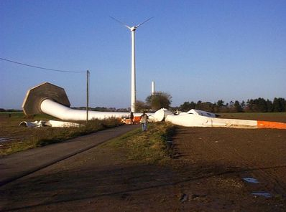
Can we blame OEMs?
No OEM wants to have to turn down WTGs (reputation, yield)
Done to avoid excessive vibration trips hitting availability targets – which client uses as an incentive to the OEM
And to avoid this happening:
A clean MLA and high AEP wins tenders
MLA only as good as the data, the model and the scenario
We need more open and honest communication

Slide 8
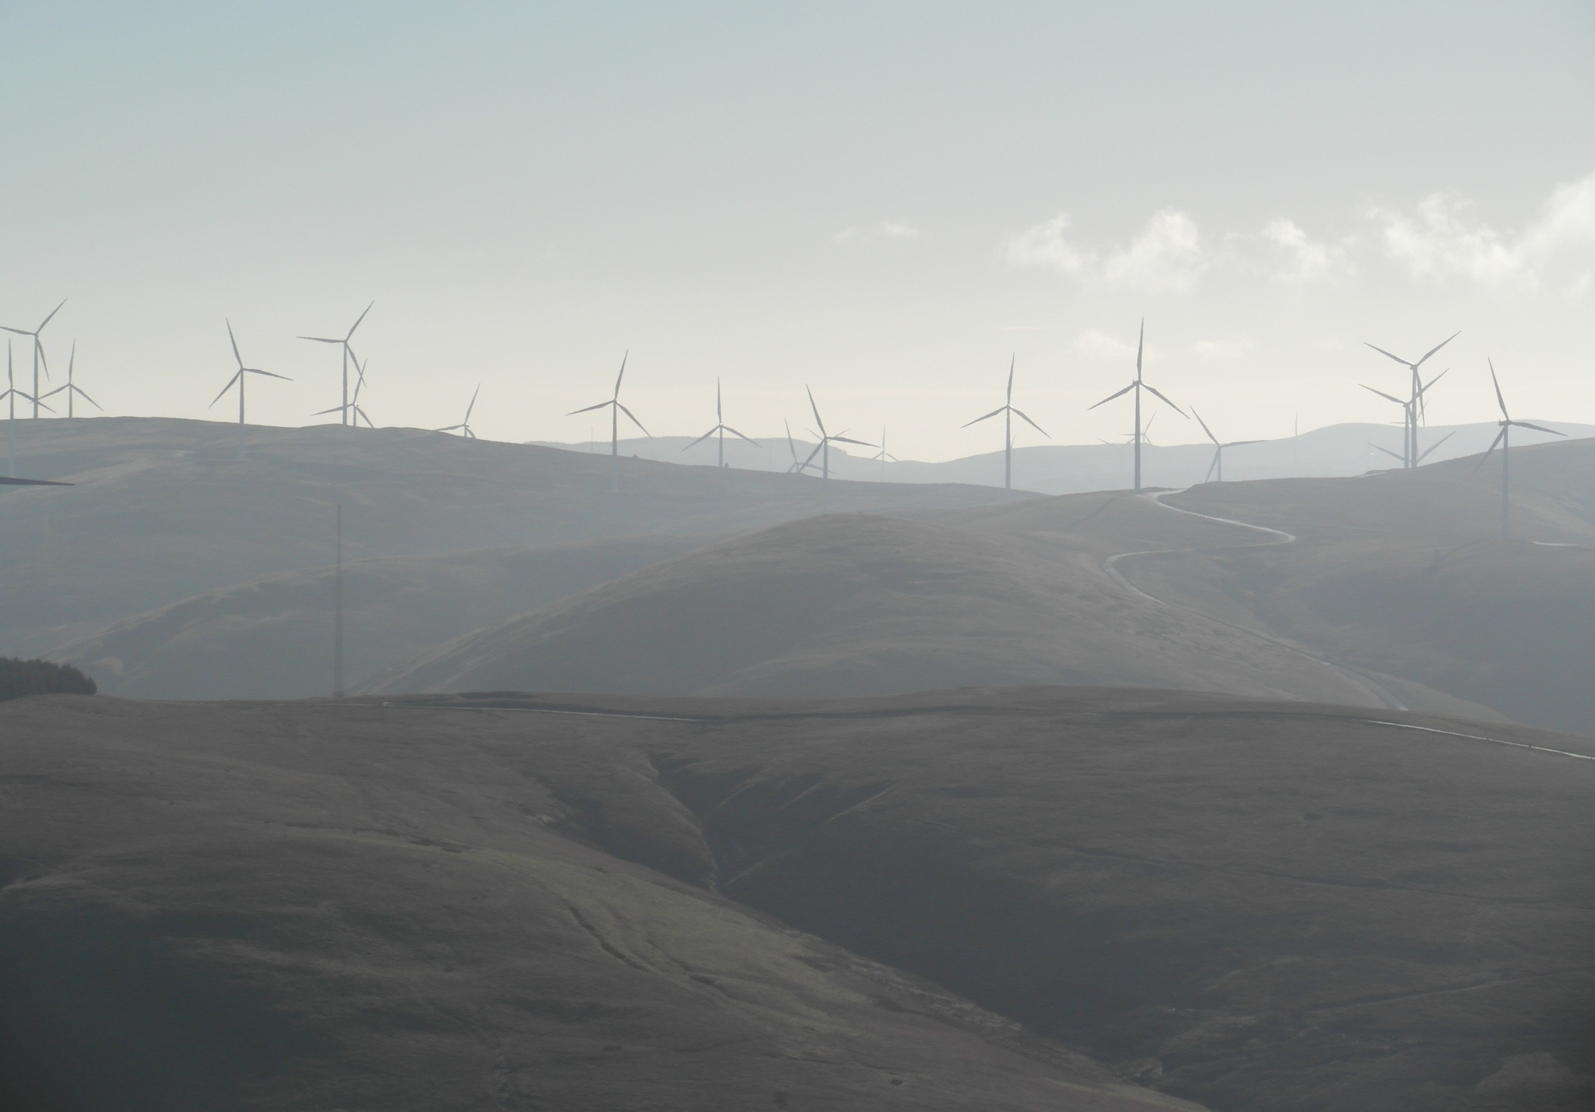
2) Mitigating the risk of underperformance

Slide 9
Warranties and IPCTs
Traditional approach to mitigating risk
SSE current policy is to test each new turbine model bought
Decision to test according to IEC 61400-12-1 (via an IPCT) is made according to risk profile of site (size, technology)
6 IPCTs carried out by SSE to date
All in moderate – complex terrain
“Successfully” argued against testing > 1 WTG
Average efficiency: ~98%, this appears to match the industry average*
Is this still a sufficient way of mitigating risk?
* EWEA Lyon, July 2012, Keir Harman (GLGH)

Slide 10
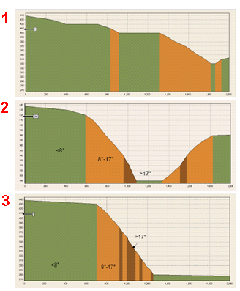
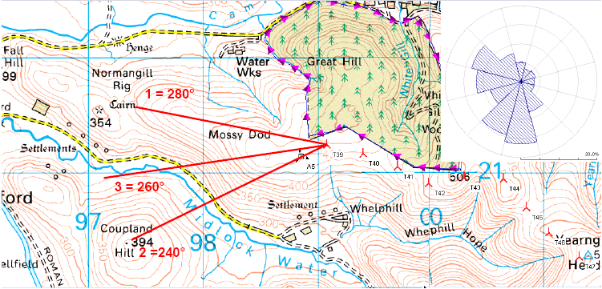
Independent Power Curve Tests
Achieving IEC-61400-12-1 compliance rarely straightforward
Site calibrations the norm for SSE sites
Sectors restricted by shear, inflow, turbulence characteristics
E.g. Clyde
* EWEA Lyon, July 2012, Keir Harman (GLGH)

Slide 11
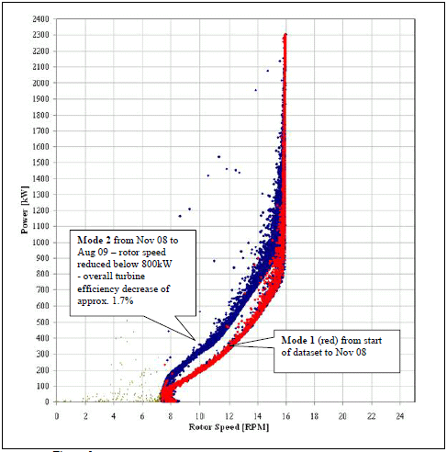
Independent Power Curve Tests (2)
An IPCT doesn’t mitigate the risk of underperformance
Only based on 1 or a few WTGs
IPCT always achieves > 95%; (100% - uncertainty)
OEM can (and does) change pitch/rpm settings during WOM
OEM often demands multiple test WTGs to mitigate risk → £££
Benefits: provides testers with a body of evidence for making pragmatic adjustments to AEPs
How to test Intelligent power control systems? Settings can change every 10 minutes!

Slide 12
Alternative means of mitigating risk
Move to yield-based warranties?
Involves a shift in paradigm away from incentivising high availability
Operator’s Power Curve Tests
A more flexible approach to ‘IEC conditions’ → more representative of actual conditions
Use of Remote sensing
Accept it won’t form the basis of a warranty
Apply pragmatic adjustments to AEPs
As an uncertainty or a loss factor?
Through better site design
We need more open and honest communication between Developers and OEMs

Slide 13
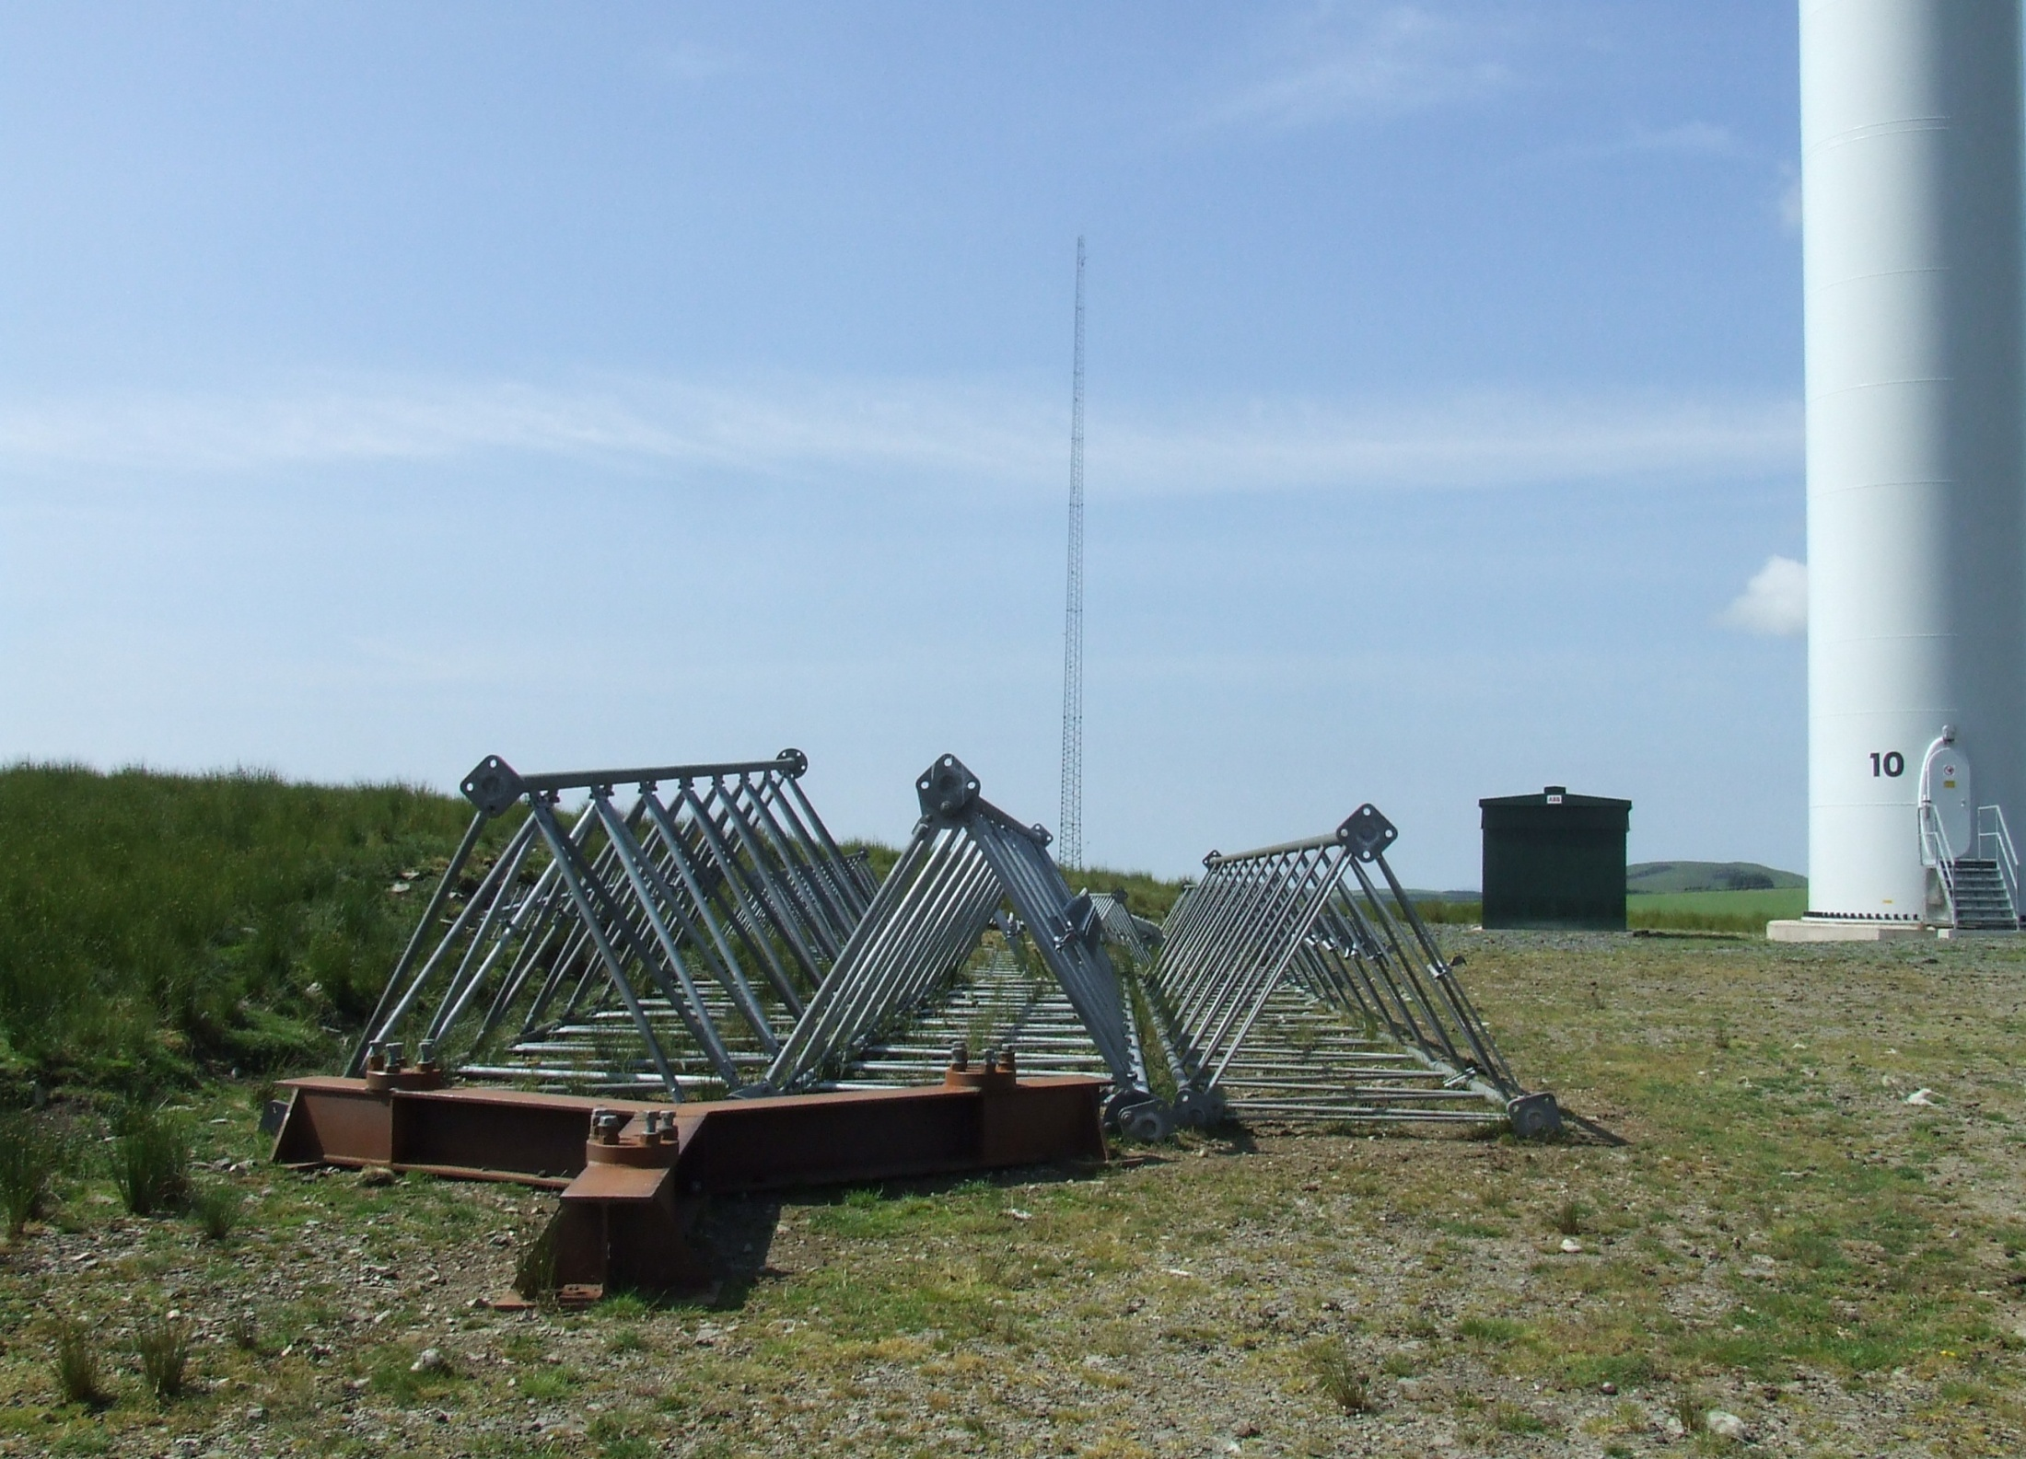
3) Working closer

Slide 14
Working closer
Ideal: involve OEM in early design work → commercially feasible?
Ambition: Move away from MLA being a black box...
RISK SHARING APPROACH
Developer provides LT wind climate at each WTG
CFD, RS, Lidar overfly data: not just raw mast data
Careful consideration given to which scenario presented
OEM works with developer to deliver:
realistic power curves for WF lifetime
optimised control strategy for yield, loading, noise.
Best and worst case scenarios presented (if applicable)
Resulting AEP is a hybrid of both parties’ expertise
Consultant provides DD
Notes:
Avoid discrepancies between OEM & Developer’s AEP
Further incentives needed?

Slide 15
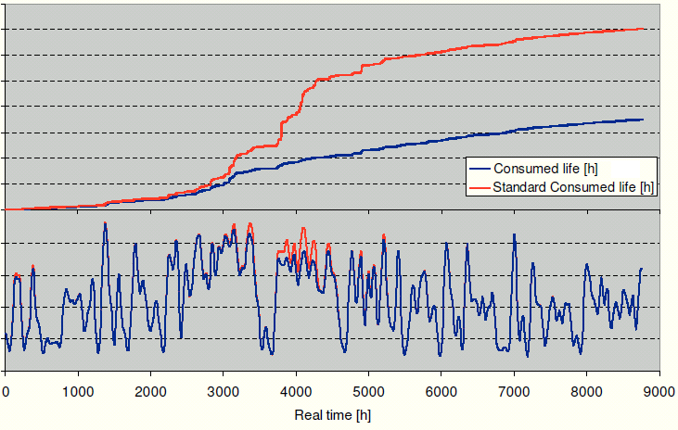
Intelligent Power Control Systems
2 key types:
Load control systems 2. Yield improvement systems (OWFs)
Former monitors and manages lifetime load cycle consumption. Allows WTG design envelope to be pushed.
Both controlled by sensors in turbine detecting onerous/advantageous wind conditions and selecting power curves on sub 10 minute basis.
Excluded from IPCTs
Little guidance on how to predict impact on AEP
Difficult to assess actual impact
Certification challenging

Slide 16
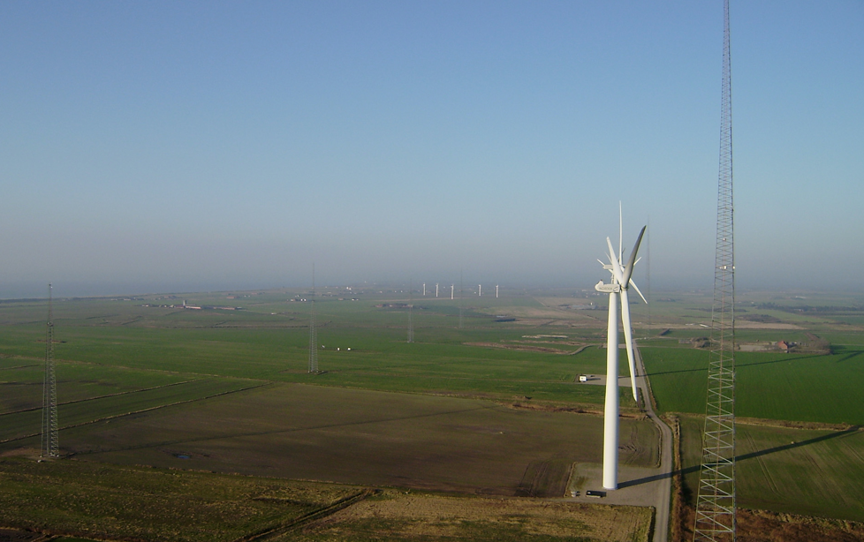
Conclusions
Not all sites look like Høvsøre!
Warranties only offer limited assurance
Quantifying effects of onerous wind conditions on
power performance is challenging
Incentivising availability can sacrifice yield
MLAs have been too ‘black box’ to date
Turbines are getting cleverer
All parties have the ability to effect improvements

